Slide 1
Click HERE for one of the coolest videos you will ever see!!!

Slide 2
Ecosystem – all the living (biotic) and nonliving (abiotic) factors in a specific area that are interdependent of one other
Click me to better understand what an ecosystem is!

Slide 3
Biome - region of the world with similar climate, animals and plants. There are terrestrial (land) biomes and aquatic (water) biomes.
Click me to visit different biomes!

Slide 4
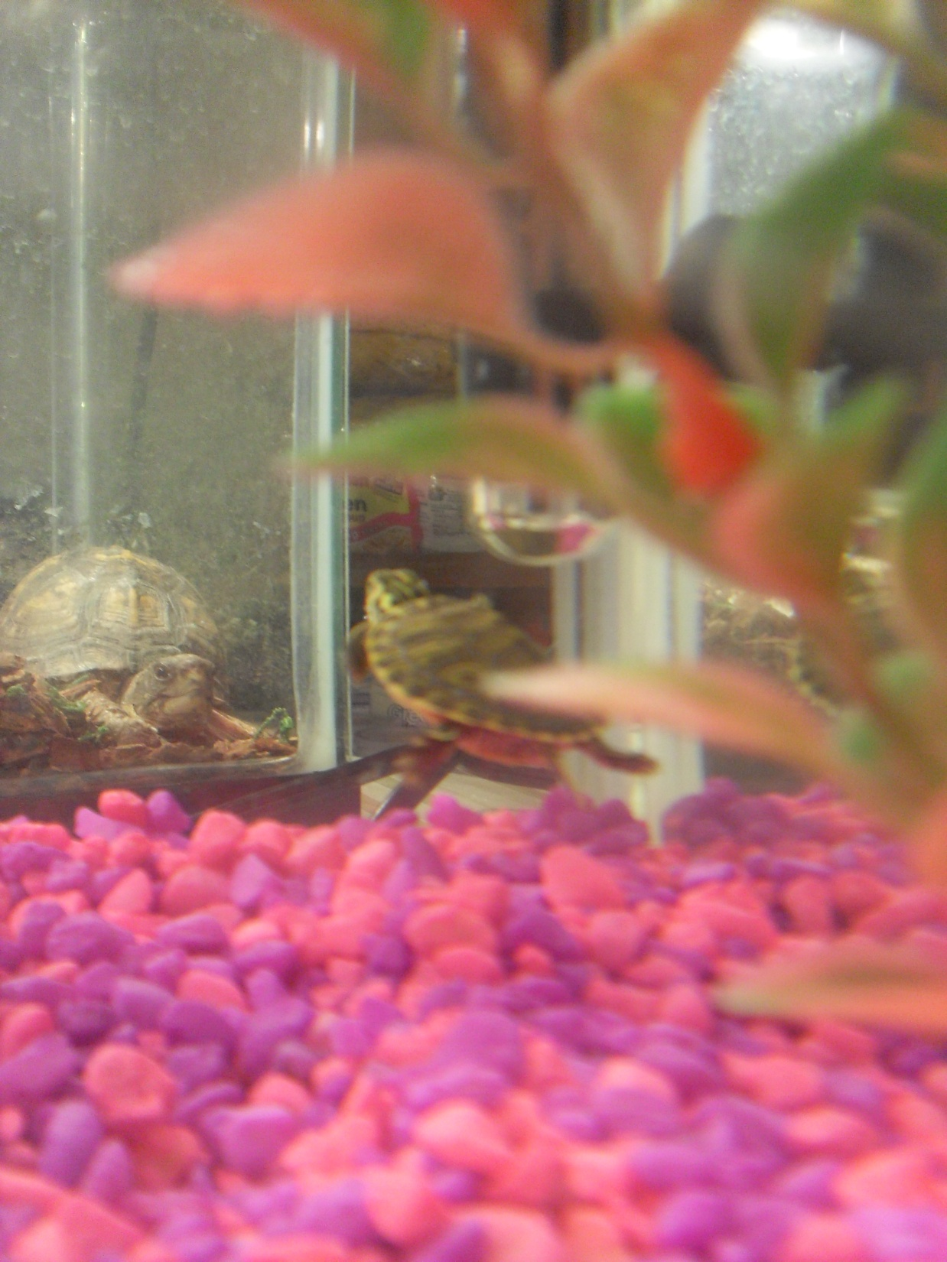
List all of the
biotic and abiotic factors
in the terrestrial and the aquatic turtle tanks.

Slide 5
Aquatic
Terrestrial
Biotic
Abiotic
Biotic
Abiotic

