Slide 1
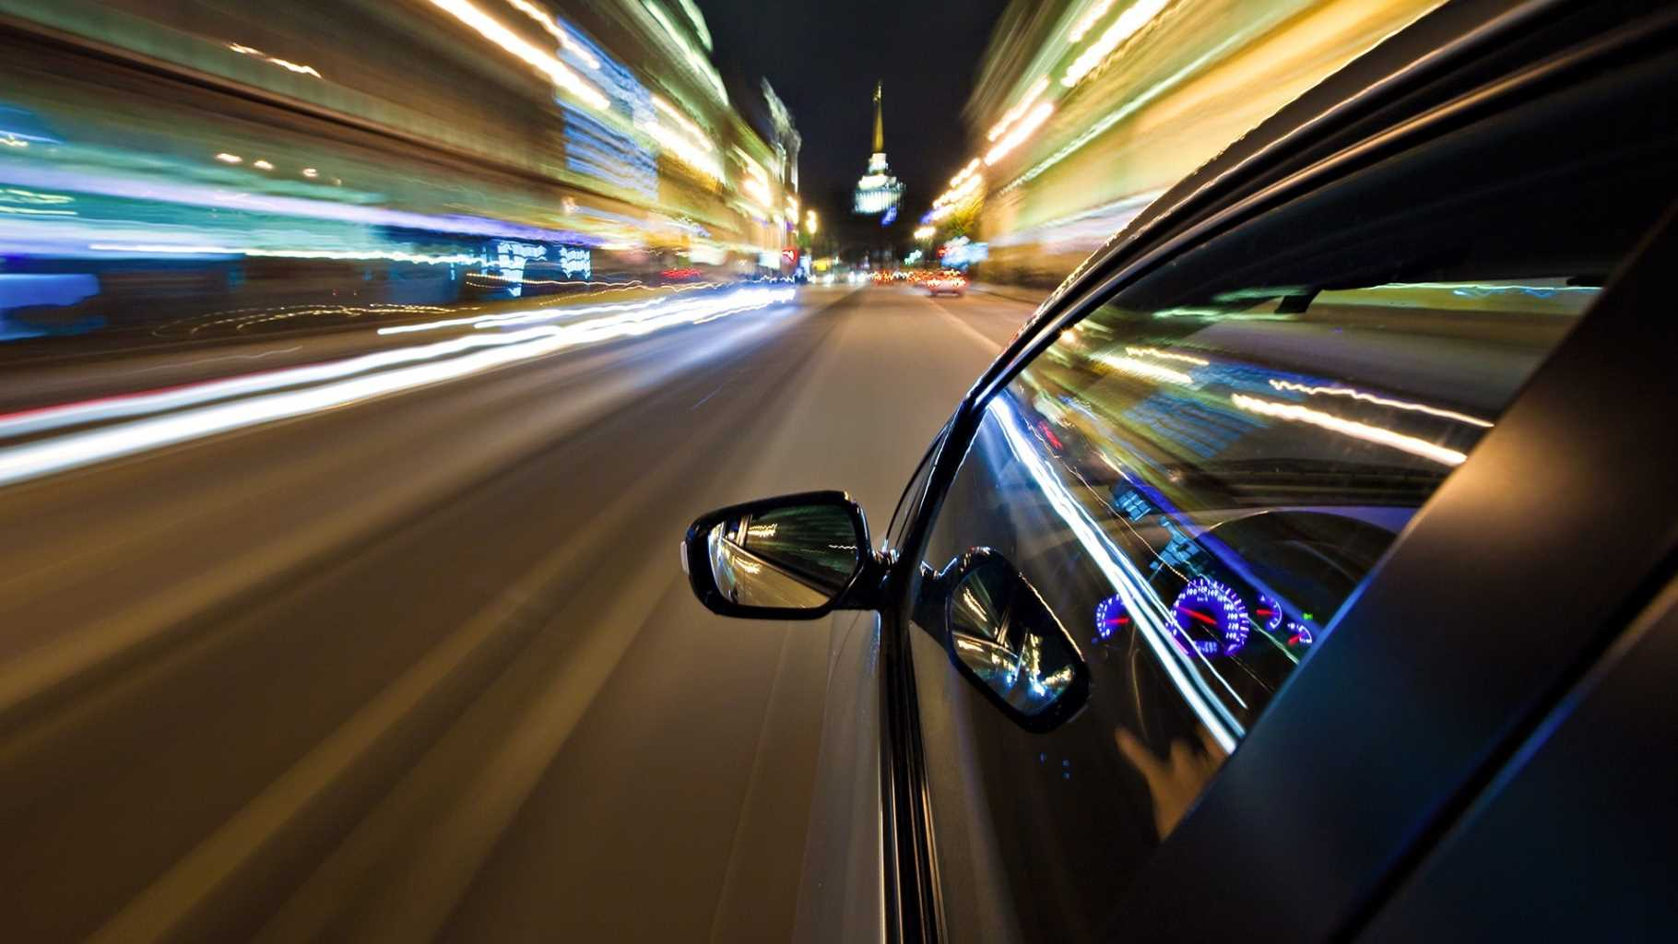
Force and Motion Vocabulary Rivet
Goal: Guess the word before I finish writing it!

Slide 2
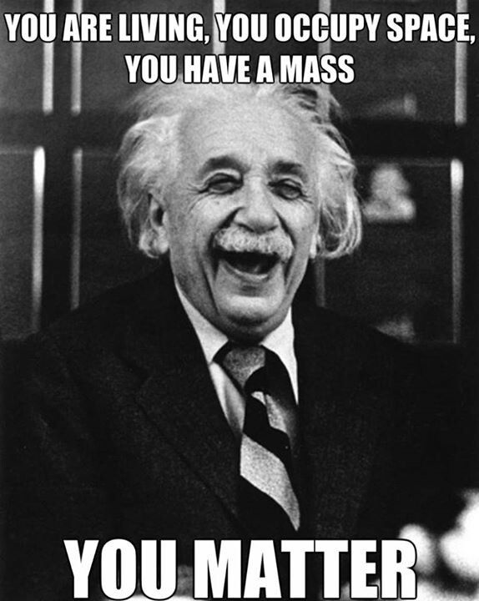
__ __ __ __ __ __ __
The study of energy and matter and how the two interact

Slide 3
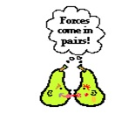
__ __ __ __ __
A push or pull that acts on an object

Slide 4
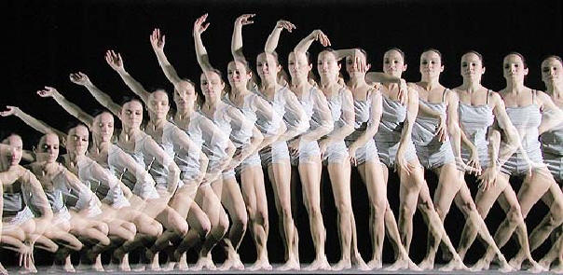
__ __ __ __ __ __
A change in an object's position

Slide 5
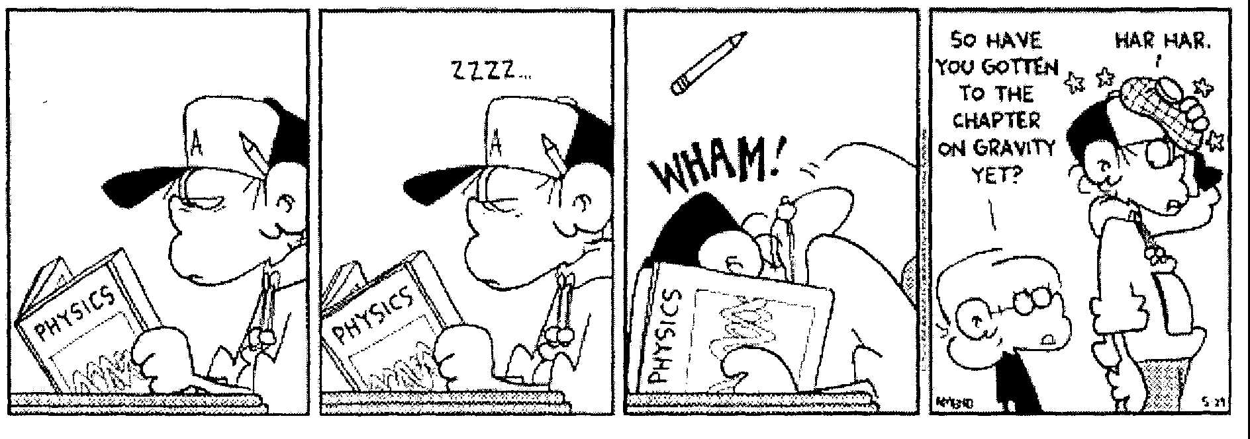
__ __ __ __ __ __ __
An attraction between the mass of the Earth and the mass of the object

Slide 6
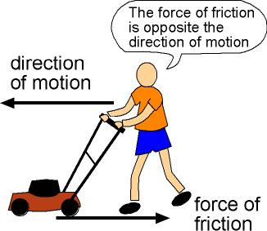
__ __ __ __ __ __ __ __
A force that opposes (acts against) a moving object

Slide 7
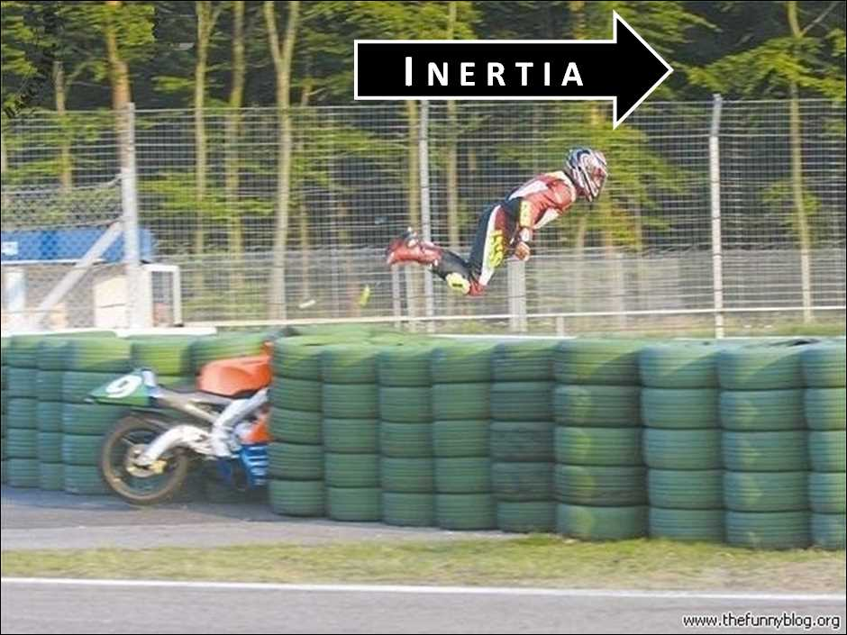
__ __ __ __ __ __ __
The tendency of an object to resist (stop) a change in motion

Slide 8
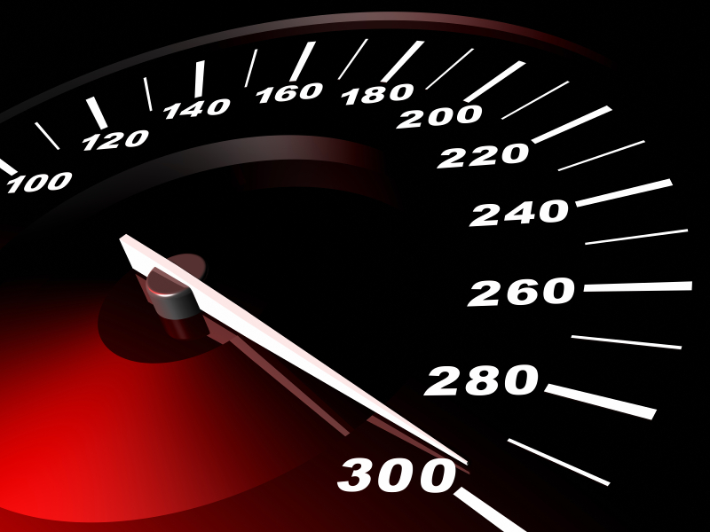
__ __ __ __ __
The change in an object's position over time

Slide 9
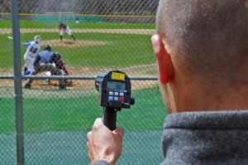
__ __ __ __ __ __ __ __
The speed of a moving object with its direction of travel

Slide 10
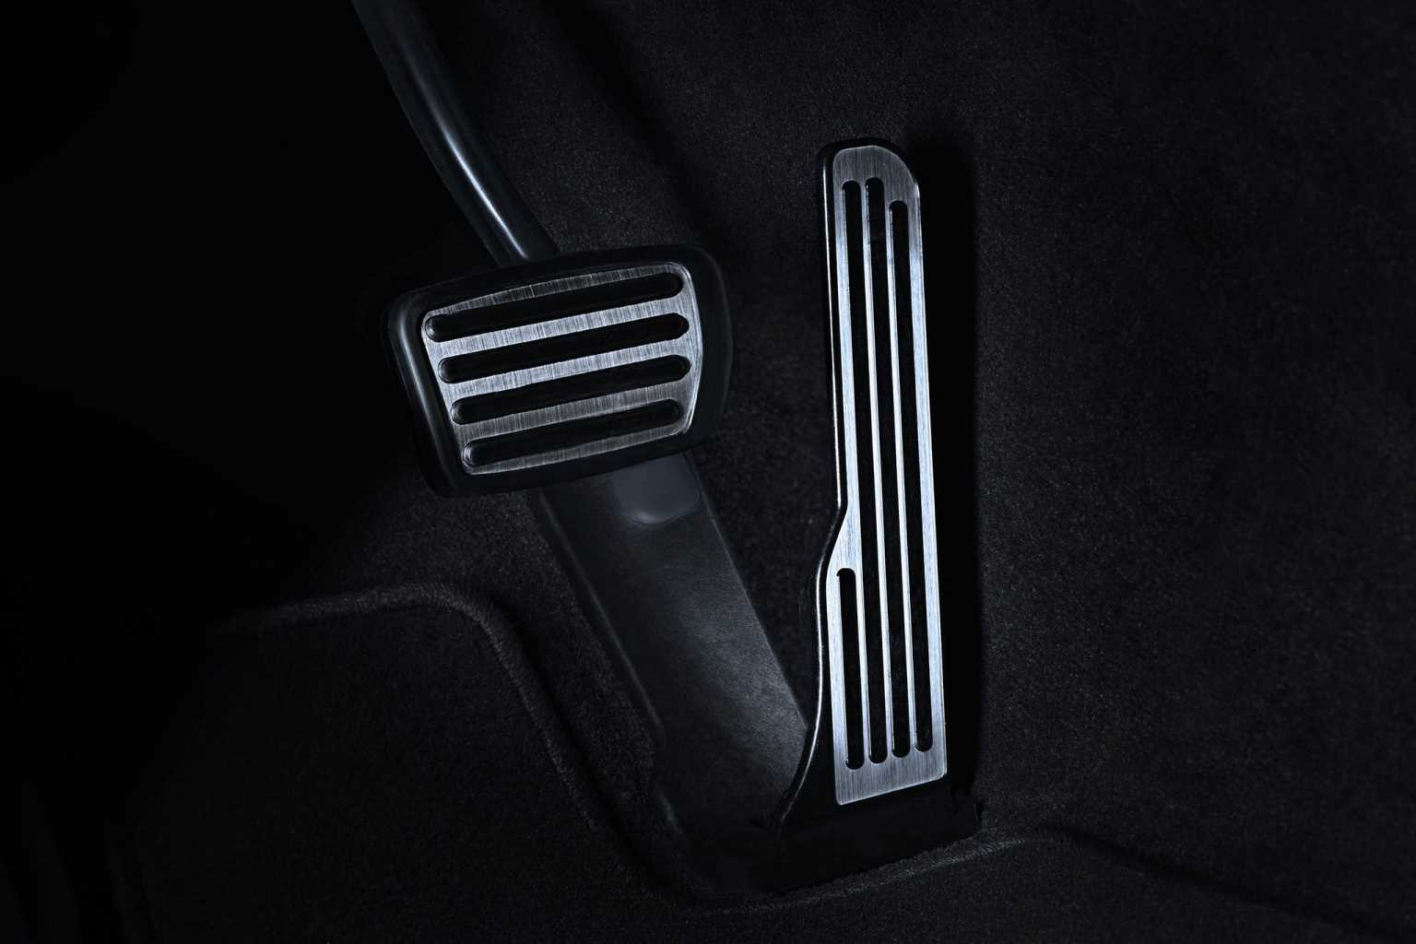
__ __ __ __ __ __ __ __ __ __ __ __
A change in an object's velocity

Slide 11
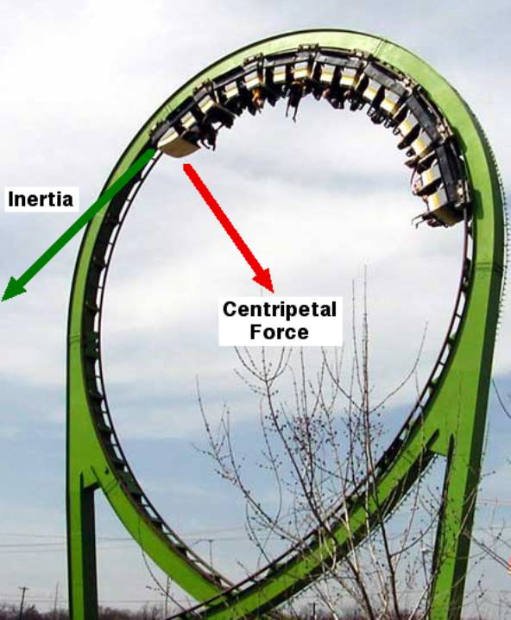
__ __ __ __ __ __ __ __ __ __ __
__ __ __ __ __
A force that pulls an object to the center of a rotation

