Slide 1
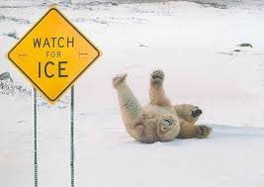
Friction Notes
Notes take Oct. 14, 2014
Page 18 in your notebook

Slide 2
Friction
Friction can be both good and bad.
Advantages – my food stays on the silverware; falling off the side of a building; throwing a football
Disadvantages = car engine parts sticking together; Slip-n-Slide; ice skating, bike or roller blades
When friction is high, the surface is rough and bumpy.
When friction is low, the surface is smooth.
When two objects are rubbed together, energy is released in the form of heat and sound.

