Slide 1
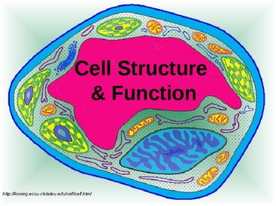
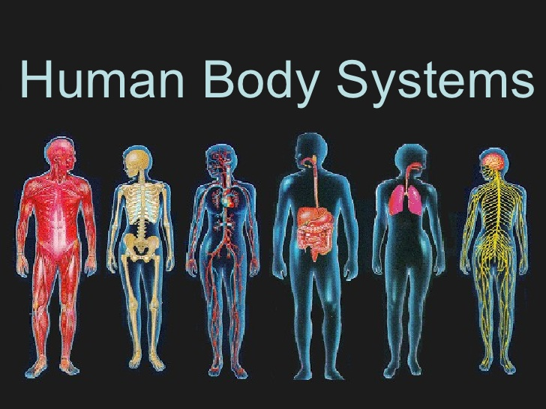
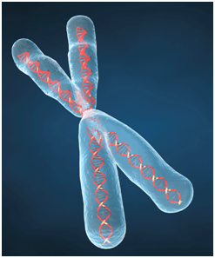
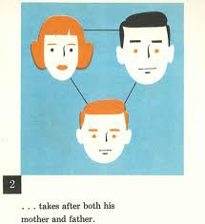
Genetics, Human Body and Heredity
Vocabulary Rivet
Objective: Guess the vocabulary word before I finish writing it.

Slide 2
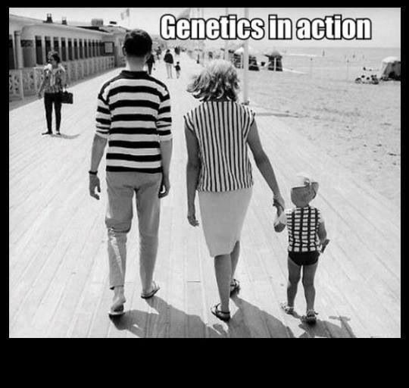
__ __ __ __ __ __ __ __
The study of genes, heredity and variation in living organisms.

Slide 3
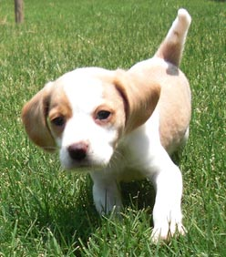
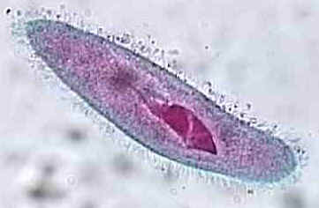
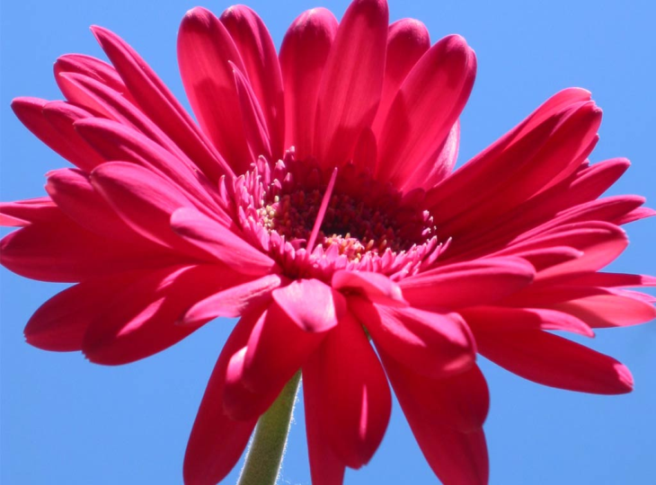
__ __ __ __ __ __ __ __
An individual animal, plant or single-celled life form

Slide 4
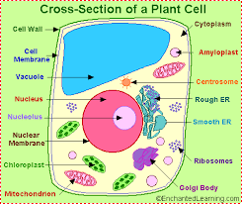
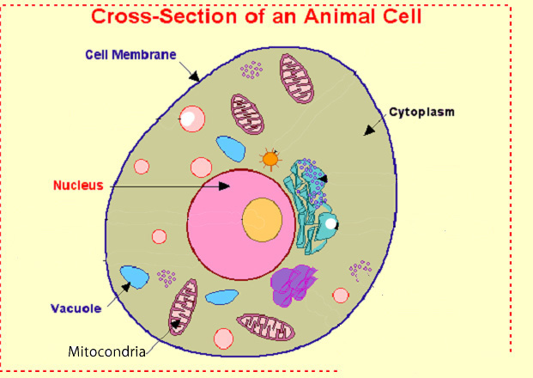
__ __ __ __
The smallest unit of an organism; usually microscopic

Slide 5
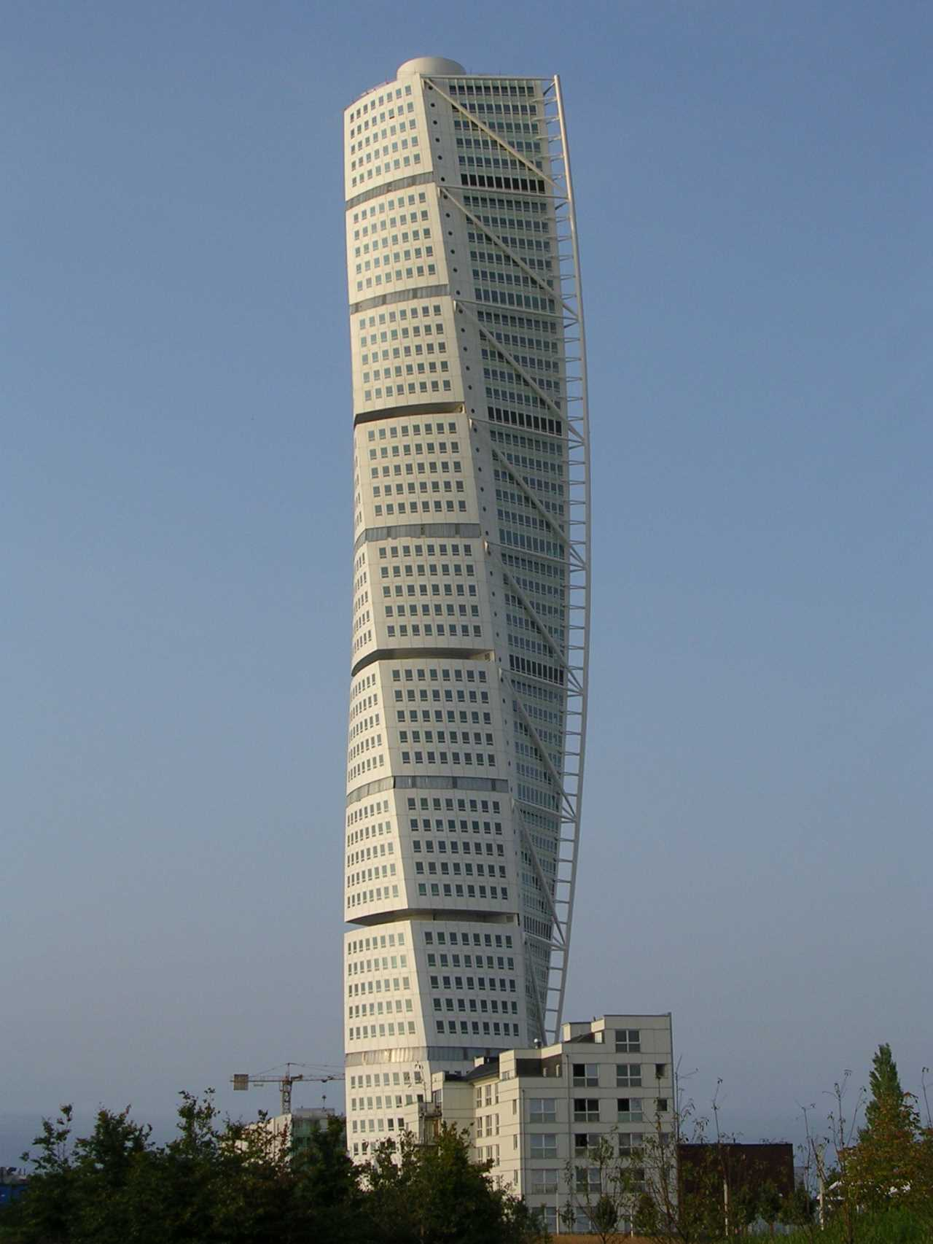
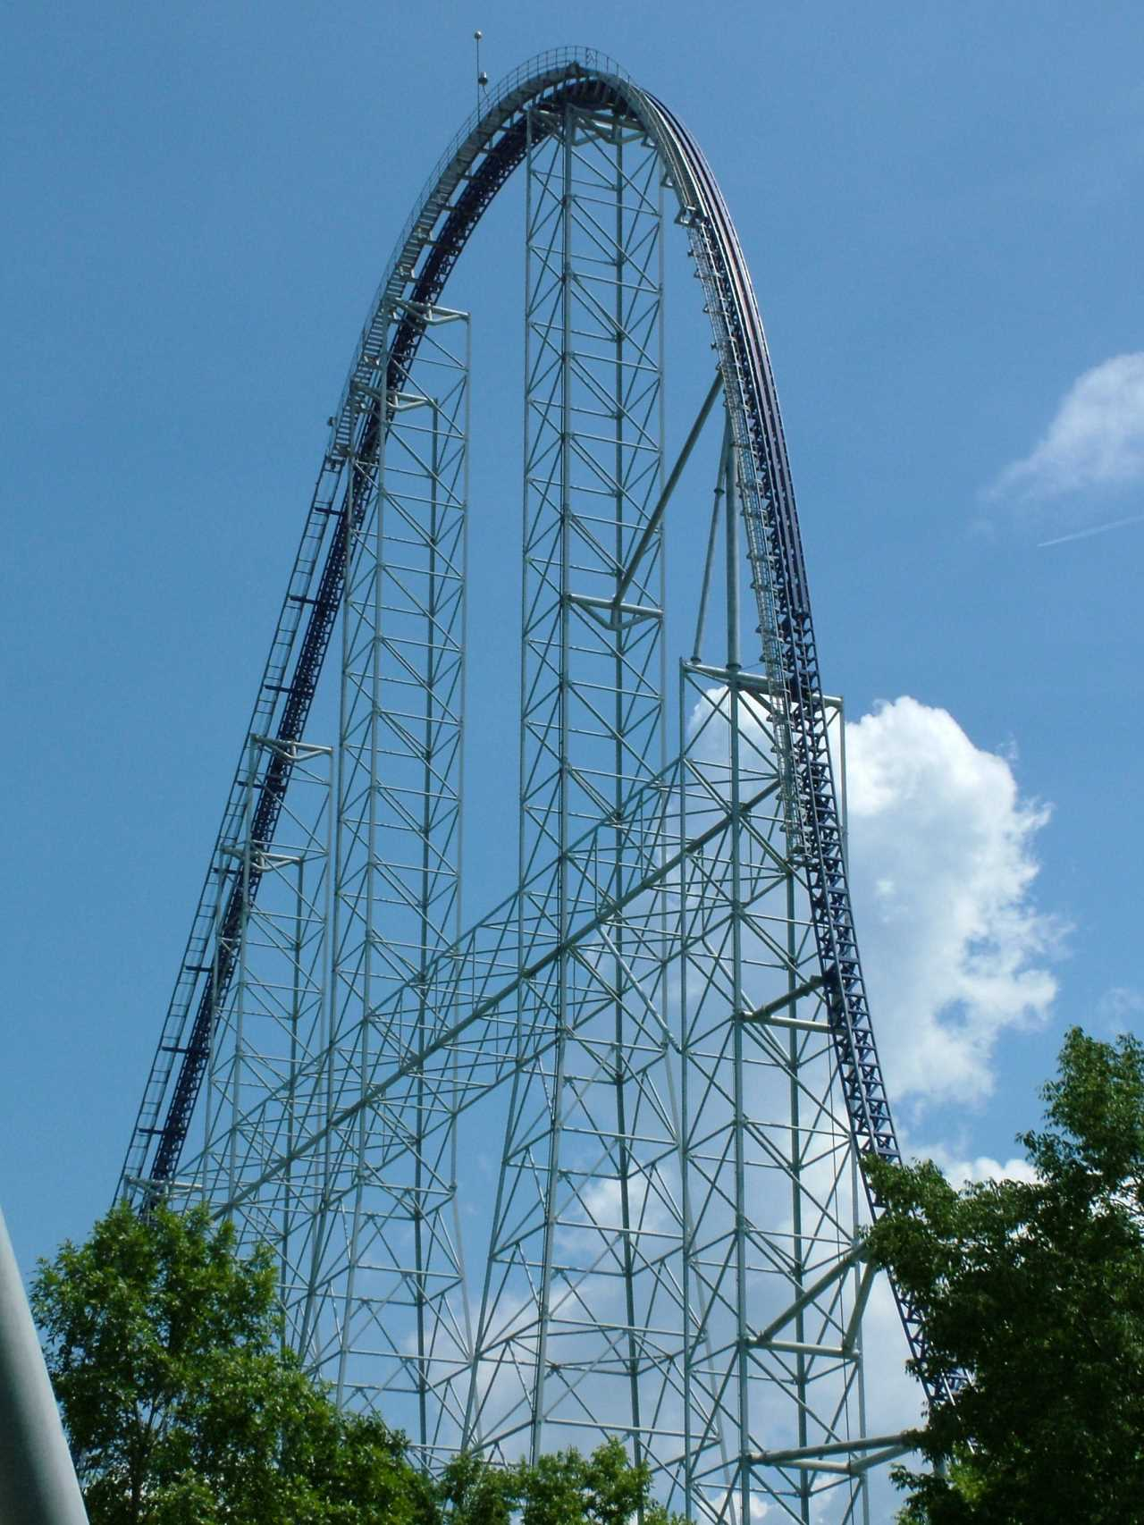
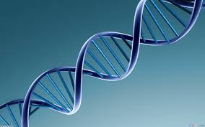
__ __ __ __ __ __ __ __ __
What something is made of; its the parts and how it is put together.

Slide 6
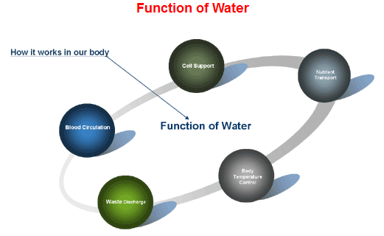
__ __ __ __ __ __ __ __
What something does or what job it has.

Slide 7
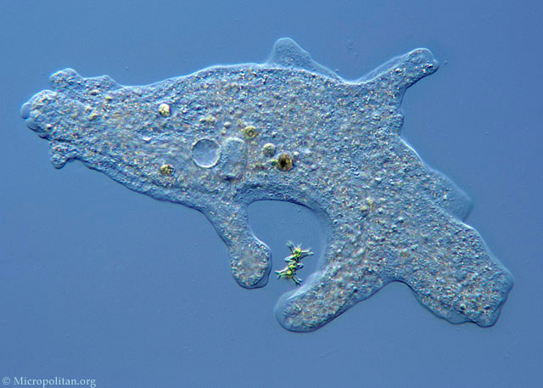
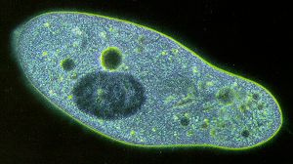
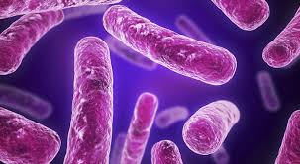
__ __ __ __ __ __ __ __ __ __ __
__ __ __ __ __ __ __ __
An organism that consists of a single cell.
Amoeba
Paramecium
Bacteria

Slide 8
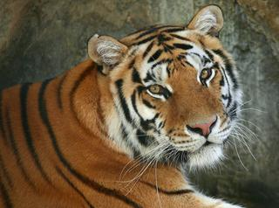
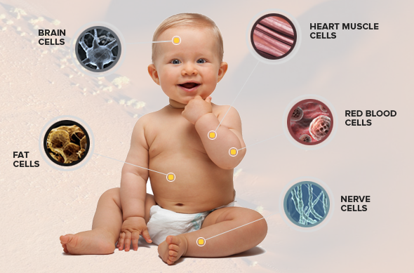
__ __ __ __ __ __ __ __ __ __ __ __ __
__ __ __ __ __ __ __ __
Organisms that consist of more than one cell.

Slide 9
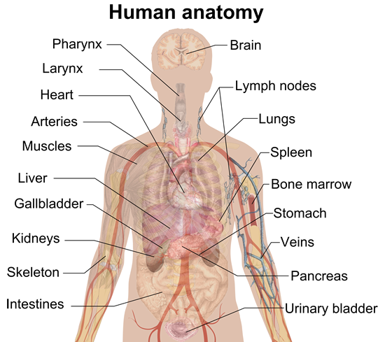
__ __ __ __ __ __ __
The study of the structure of an organism

Slide 10
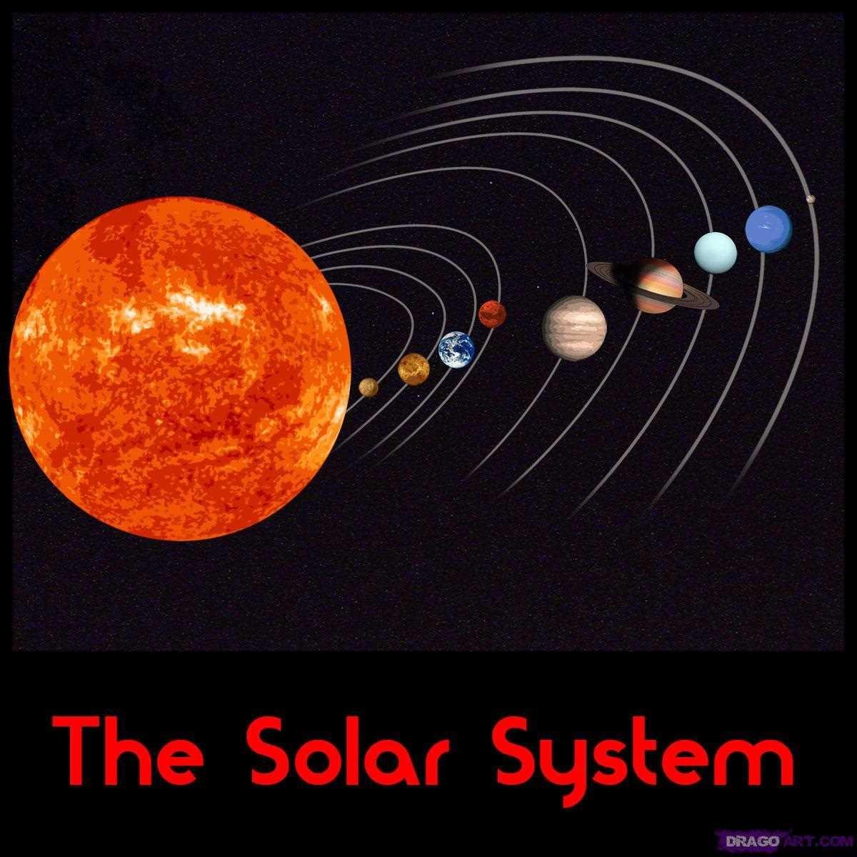
__ __ __ __ __ __
A set of connected parts forming a complex whole.

Slide 11
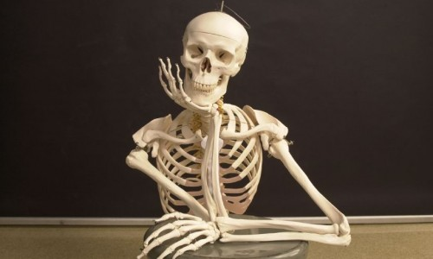
__ __ __ __ __ __ __ __
__ __ __ __ __ __
All of the bones and joints of the body

Slide 12
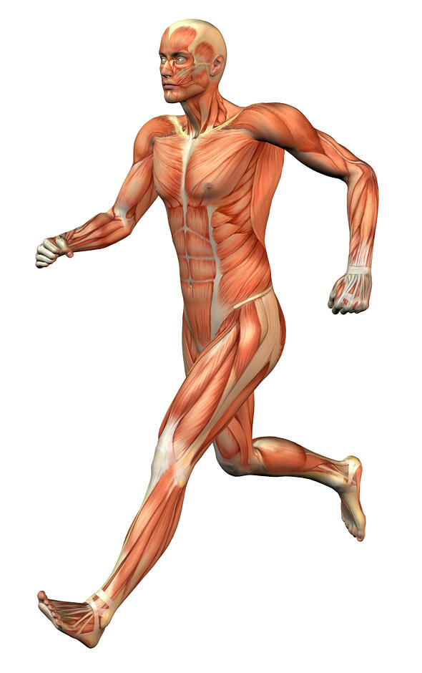
__ __ __ __ __ __ __ __
__ __ __ __ __ __
All of the muscles in the human body that are attached to bones

Slide 13
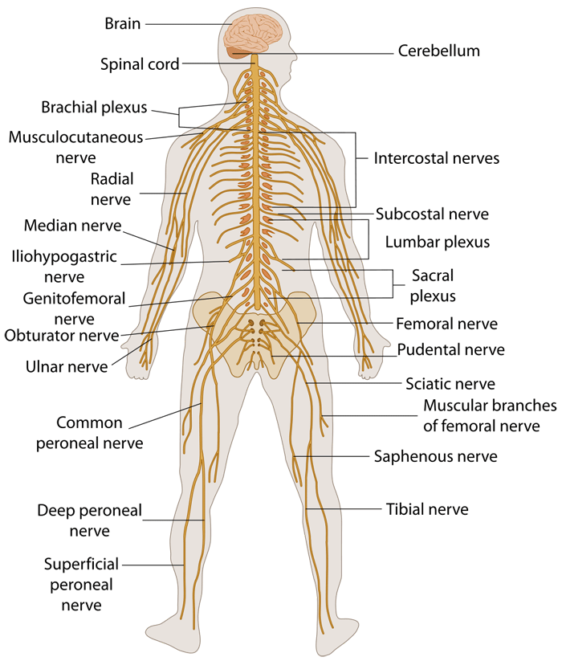
__ __ __ __ __ __ __ __
__ __ __ __ __ __
The network of nerve cells that transmit signals between different parts of the body.

Slide 14
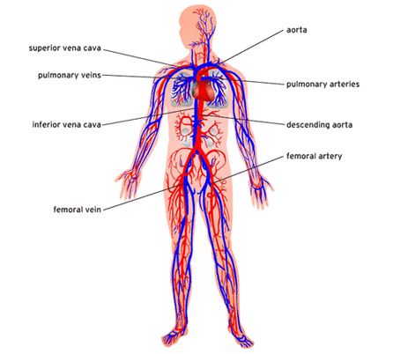
__ __ __ __ __ __ __ __ __ __ __
__ __ __ __ __ __
The system that is responsible for transporting materials throughout the entire body; also known as the
Cardiovascular System

Slide 15
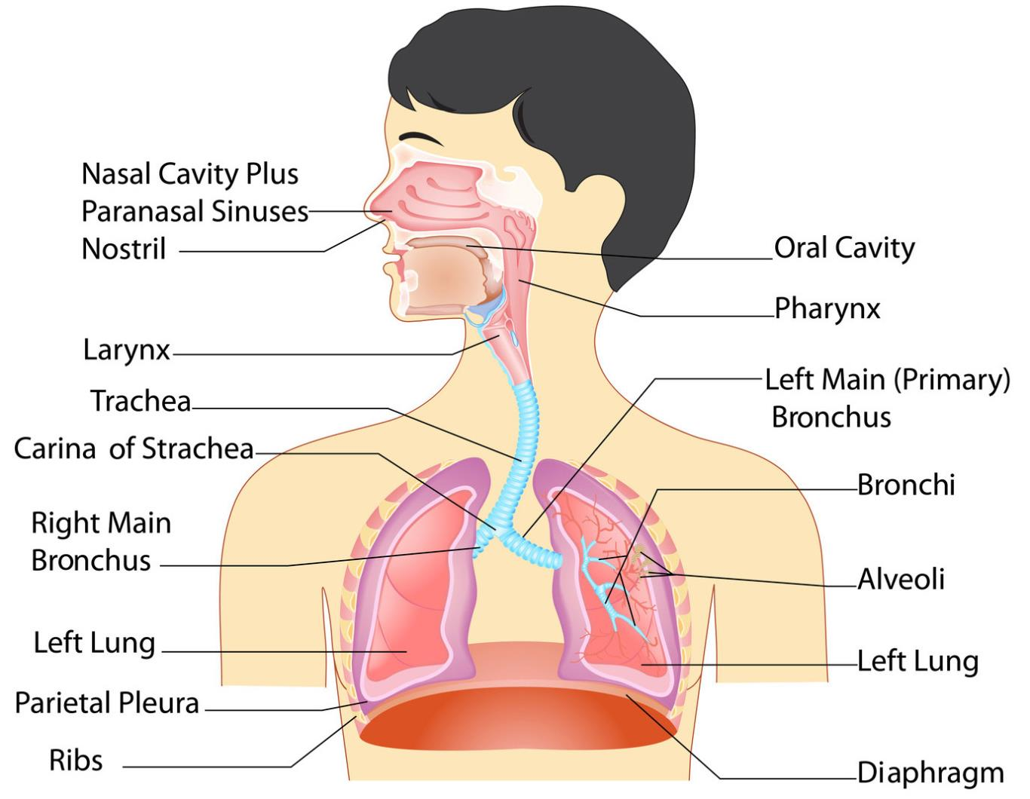
__ __ __ __ __ __ __ __ __ __ __
__ __ __ __ __ __
The system that is made up of the organs that help you breath.

Slide 16
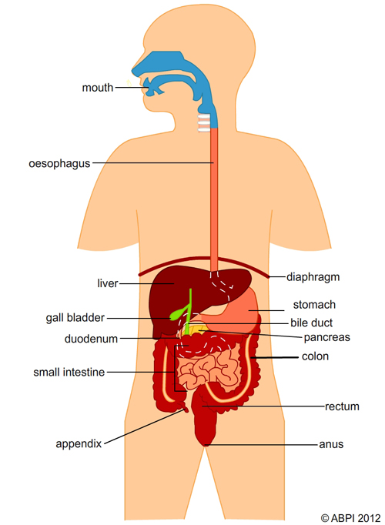
__ __ __ __ __ __ __ __ __
__ __ __ __ __ __
The organs that work together to convert food into energy for the entire body.

Slide 17
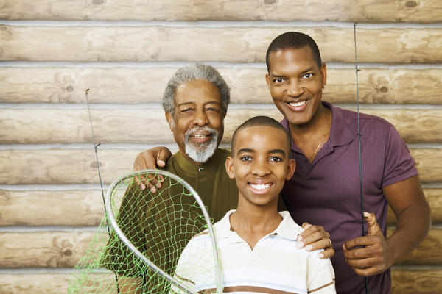
__ __ __ __ __ __ __ __
The passing of traits from parents to offspring.

Slide 18
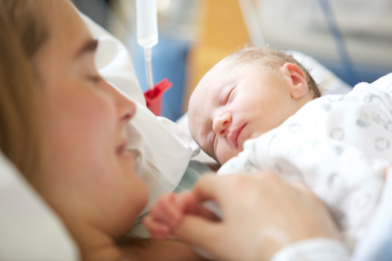
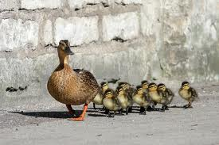
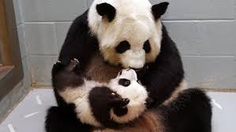
__ __ __ __ __ __ __ __ __
A person's child or an animal's young

Slide 19
__ __ __ __ __ __ __ __ __ __ __ __ __ __
A feature or quality that belongs to something and is used to identify it

Slide 20
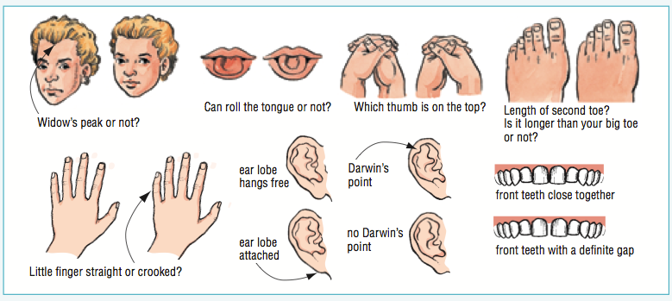
__ __ __ __ __ __ __ __ __
__ __ __ __ __ __
A trait from one's parents by genetic transmission.

Slide 21
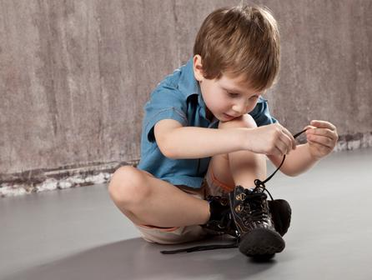
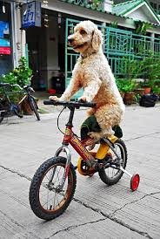
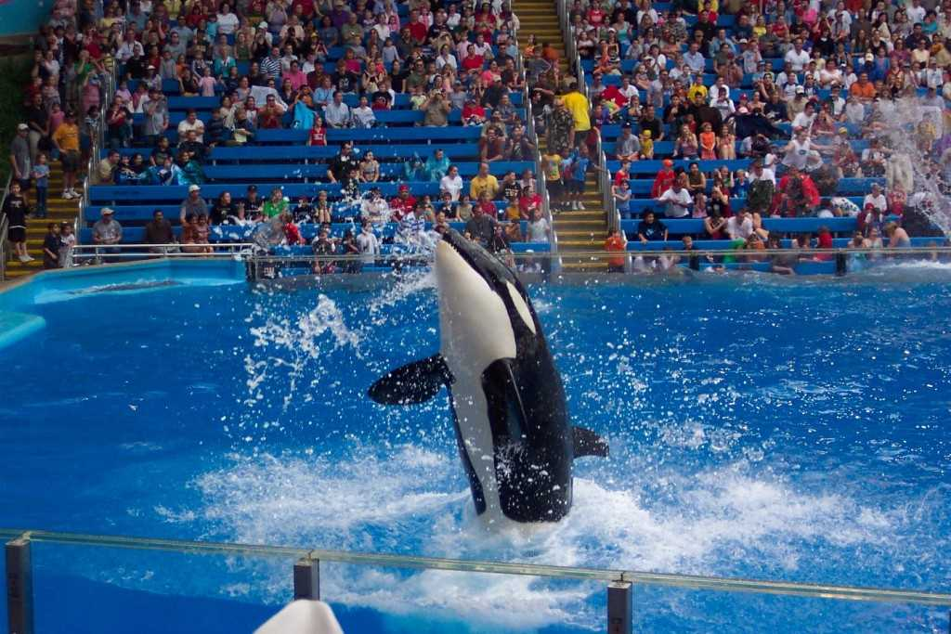
__ __ __ __ __ __ __
__ __ __ __ __ __ __ __
A behavior that an animal develops by observing other animals or by being taught

