Slide 1
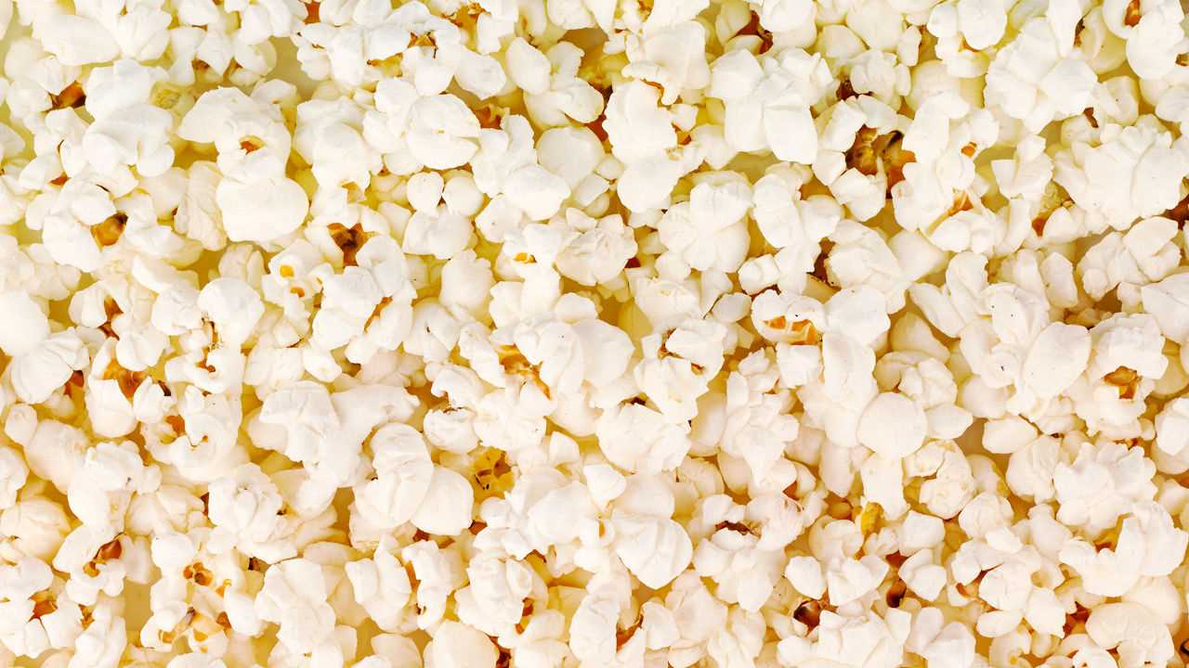
Heat Transfer
Popcorn Lab
Question: How can we use conduction, convection and radiation to pop popcorn kernels?

Slide 2
Talk with your neighbor about
a time when you made popcorn.
- How did you make it?
- Did you need help making it?
- What did it taste like?
- Did you burn your tongue or hand while eating it?

Slide 3
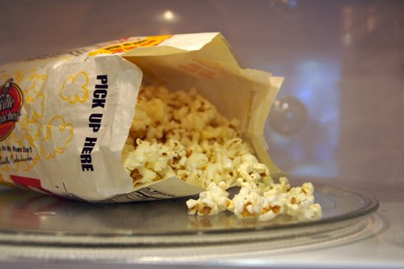
Microwaved Popcorn
1. Make observations as the popcorn is popped.
2. How are the kernels heating?
3. What type of heat transfer is this?
 | Color | Smell | Texture | Taste
Microwave
Stovetop
Air Popper

Slide 4
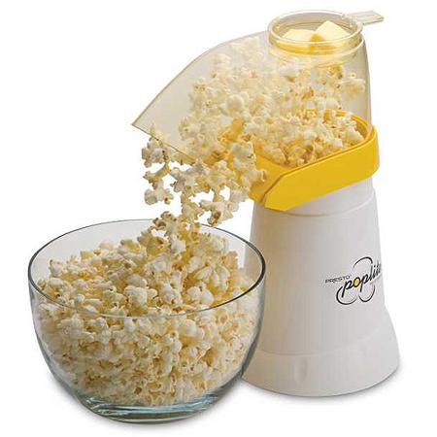
Popcorn Popper
1. Observe what happens as the popcorn is popped.
2. How are the kernels heating?
3. What type of heat transfer is this?
 | Color | Smell | Texture | Taste
Microwave
Stovetop
Air Popper

Slide 5
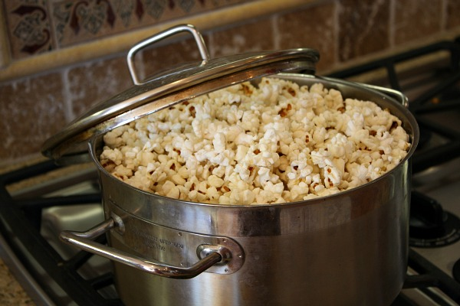
Stovetop Popcorn
1. Observe what happens
as the popcorn is popped.
2. How are the kernels heating?
3. What type of heat transfer is this?
 | Color | Smell | Texture | Taste
Microwave
Stovetop
Air Popper

Slide 6
EXIT TICKET
Write the type of heat transfer that was present in the...
1. Stovetop - _____________
2. Air Popper - ____________
3. Microwave - ____________

