Slide 1
Inertia Demonstrations
Notes from: Oct. 13, 2014
Page 16 in notebook

Slide 2
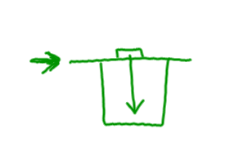
#1 – Cup Magic
A force is applied to the card which sets it in motion. The coin’s inertia keeps it still and gravity pulls it to the bottom of the cup.

Slide 3
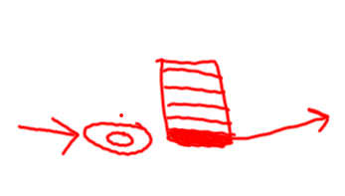
# 2 – Wacky Washers
The single washer was pushed into the bottom, red washer of the stack. The bottom washer is set into motion and the rest of the stack stays at rest.

Slide 4
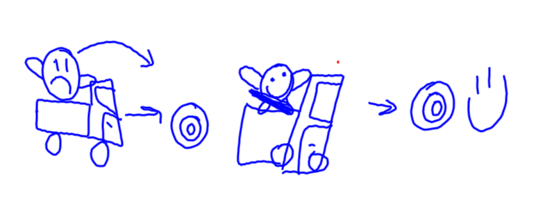
#3 – Hold on Tight

Slide 5
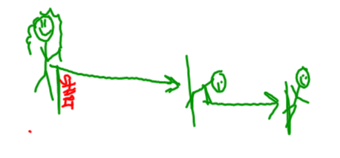
#4 – Running Stop
My body is in motion from running. When I stop on the line, my feet stop, but the top of my body keeps going and I almost fall over.

Slide 6
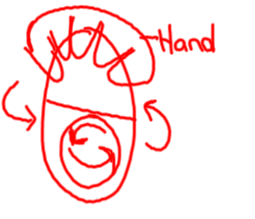
#5 – Spinning Eggs
The egg and ping pong ball are both set into motion. I apply the outside force to stop the egg from spinning, but the ping pong ball remains in motion.

Slide 7
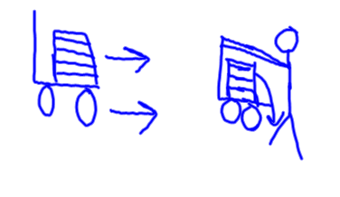
#6 – Books on Wheels
Both the chair and books were set in motion. Someone applied a force to stop the chair. Then the books went flying.

