Slide 1
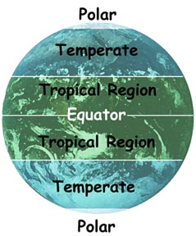
Major Climate Zones
Planet Earth can be divided into three basic climate zones:
Tropical
Temperate
Polar

Slide 2
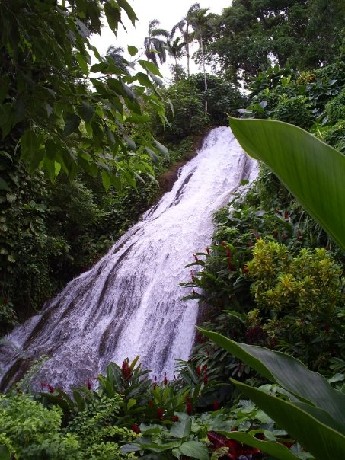
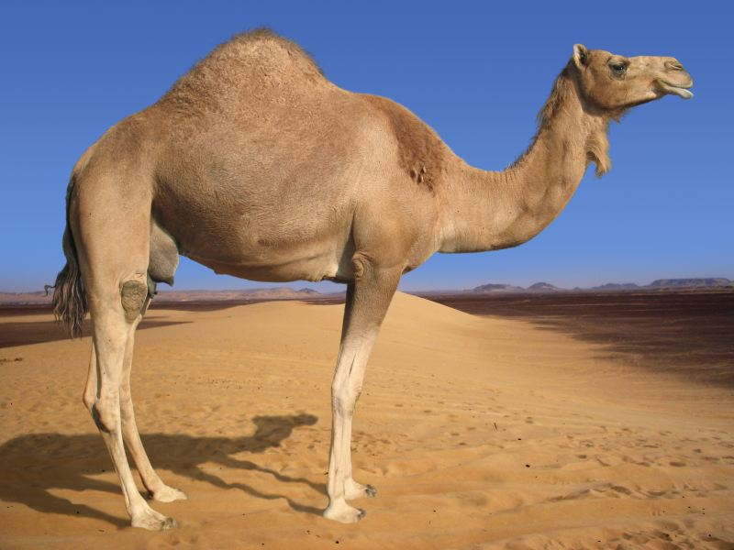
Major Climate Zones
Tropical Climates
Occur near the equator and the lower latitudes
Includes:
Rainforests that are warm, muggy, and rainy year-round.
Deserts that are hot and dry year-round.

Slide 3
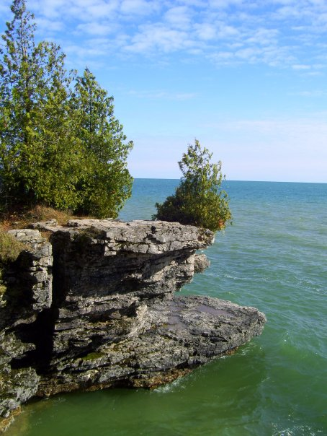
Major Climates Zones
Temperate Climates
“Temperate” means moderate or mild.
Occur about halfway between the equator and the poles in the middle latitudes.
These climates tend to have all four seasons with warm or hot summers and cool to cold winters.

Slide 4
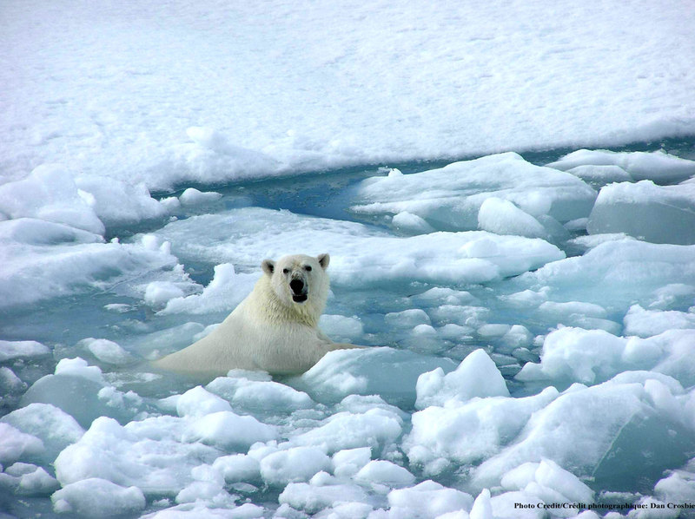
Major Climate Zones
Polar Climates
Occur near the poles at the higher latitudes
Winters are long and bitterly cold.
Summers are short and cool.
Temperatures are below freezing for more than half the year.

Slide 5
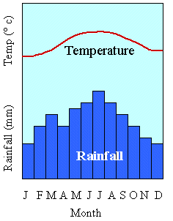
Climate-Graphs
A quick way to get an idea of the climate of a particular place is to look at a "climate-graph," or "climograph." A climograph is what scientists create to show a particular location's average temperature and precipitation during the year.
Click the graph above for an Interactive Climate Map.

