Slide 1
Newton’s Laws of Motion

Slide 2
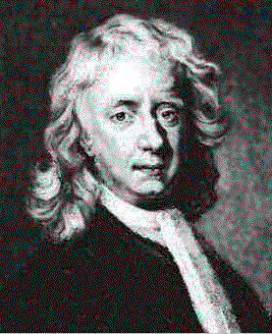
Sir Isaac Newton (1642 – 1727)

Slide 3
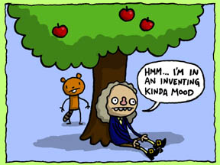
Newton’s Law of Universal Gravitation

Slide 4
Newton’s First Law - Law of Inertia
An object at rest will remain at rest, or an object in motion will remain in motion with the same speed and direction, unless acted upon by an outside force.
Objects keep doing what they’re doing…

Slide 5
Always wear your seatbelt!! It’s the law…
THE LAW OF INERTIA!

Slide 6
Newton’s Second Law - Law of Acceleration
F=ma
The greater the force applied, the faster the acceleration of the object. The greater the mass, the greater the force needed to accelerate the object.

Slide 7
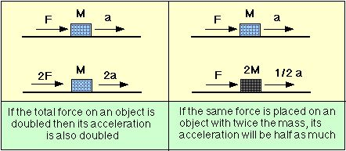
Law of Acceleration Continued
Click me! Click me too!

Slide 8
Newton’s Third Law - Law of Interaction
For every action, there is an equal and opposite reaction.
If you touch the world gently, the world will touch you back gently. If you touch the world harshly, the world will touch you harshly.

Slide 9
Law of Interaction Continued
Click me!
Click me too!
Click here for a video about balanced and unbalanced forces!

Slide 10
Check out the link below for more information about Newton’s 3 Laws and some activities you can do at home!
Newton’s Laws of Motion

