Slide 1
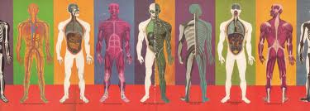
So Many Systems Review Game
Objective: Decide which systems are being used simultaneously after reading a clue.

Slide 2
How to play:
Each team has 6 different colored cards with one of the six different human body systems on each.
The teacher will give a clue to an every-day event. Your team is to quietly discuss which systems are being used during the situation.
The teacher will say, “All systems go!” and your team is to hold up the cards that are being used.
- The cards are to remain in the middle of the table until then.
If all systems are correctly shown, your team will receive a point.

Slide 3
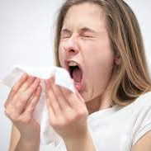
Clue #1…
I’ve got to (ah – ah – ah – choo) sneeze.
Answer:
- Respiratory
- Nervous
- Muscular
- Skeletal
- Circulatory

Slide 4
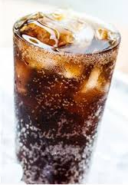
Clue #2…
Drinking this soda makes me cold.
Answer:
- Digestive
- Nervous
- Muscular
- Skeletal
- Circulatory

Slide 5
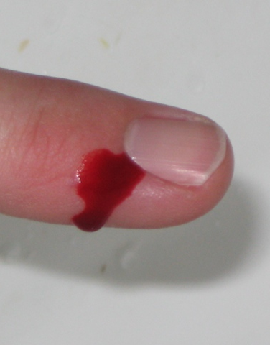
Clue #3…
I cut myself. Now I am bleeding.
Answer:
- Circulatory
- Skeletal
- Nervous
- Muscular

Slide 6
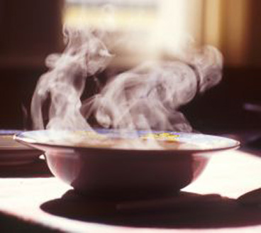
Clue #4…
I’m eating some really hot soup.
Answer:
- Digestive
- Nervous
- Muscular
- Skeletal

Slide 7
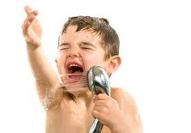
Clue #5…
I’m singing in the shower.
Answer:
- Respiratory
- Nervous
- Muscular
- Circulatory
- Skeletal

Slide 8
Clue #6…
Ouch! That bee just stung me!
Answer:
- Nervous
- Muscular
- Skeletal

Slide 9
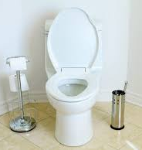
Clue #7…
Please wait for me, I need to run to the bathroom.
Answer:
- Digestive
- Nervous
- Muscular
- Skeletal

Slide 10
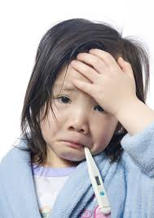
Clue #8…
I had the flu, but now I am better.
Answer:
- Digestive
- Nervous
- Muscular
- Skeletal
- Circulatory

