Slide 1
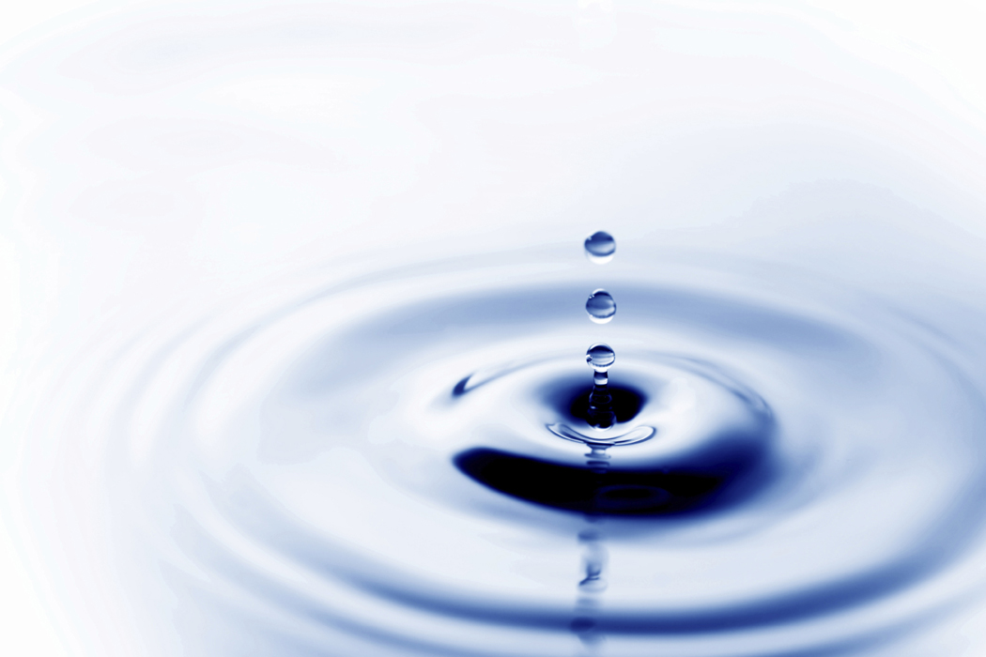
The Water Cycle
The continuous movement of different states of water (solid, liquid, gas) on Earth
AKA: The Hydrologic Cycle

Slide 2
1.) Take a good look at the water in your cup.
2.) Drink all of it.
3.) Can you guess how old
it is? Talk with your neighbor.

Slide 3
The water in your cup may have fallen from the sky as rain just last week, but the water itself has been around pretty much as long as the earth has! When the first fish crawled out of the ocean onto the land, your cup of water was part of that ocean. When the Brontosaurus walked through lakes feeding on plants, your cup of water was part of those lakes. When kings and princesses, knights and squires took a drink from their wells, your cup of water was part of those wells.
And you thought your parents were OLD!

Slide 4
Let’s close read an article called, “Did You Share Your Drink with a Dinosaur?”
1.) You must use your close reading strategies with an Expo marker directly on the protector sheet.
2.) Write all your Think Marks on sticky notes (please be resourceful with these).
3.) You may read with someone if you’d like.
4.) You have 30 min. to finish.

Slide 5
Discussion Questions:
According to the text, why did you share your drink with a dinosaur?
Which sentence in the text supports the answer to the first subtitle, “How Does Water Get To Be Rain?”
How can water be destructive to farmland? Use evidence from the text to support your answer.

Slide 6
To put all of this simply…
The earth has a limited amount of water. That water keeps going around and around and around and around in what we call the "Water Cycle".
This cycle is made up of a few main parts:
evaporation (and transpiration)
condensation
precipitation
accumulation (ground water and runoff )

Slide 7
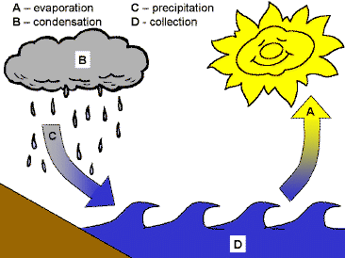
accumulation

Slide 8
Let’s break it down…
1. Evaporation
The sun heats up water in rivers, lakes or oceans and turns it into water vapor (water in the gas form). The water vapor leaves the river, lake or ocean and rises into the air.
Transpiration
The process by which plants lose water out of their leaves. Transpiration gives evaporation a bit of a hand in getting the water vapor back up into the air.

Slide 9
2. Condensation
Water vapor high in the air cools and condenses (changes back into liquid water), forming clouds.
You can see the same sort of thing at home! After you take a hot shower, you may notice that the bathroom mirror is foggy. Water vapor from the warm shower in the air, turns back into liquid when it touches the cold mirror. Thus, creating a cloud on your mirror!

Slide 10
Precipitation
Occurs when so much water vapor has condensed that the air cannot hold it anymore. The clouds get heavy and water falls back to the earth in the form of rain, hail, sleet or snow.

Slide 11
4. Accumulation
When water falls back to earth as precipitation, it may fall back in the oceans, lakes or rivers or it may end up on land. When it ends up on land, water will either:
1.) soak into the earth and become part of the “ground water” that plants use to drink and eventually ends up in oceans, lakes, rivers, etc.
2.) “run off” the land, buildings, etc. and collect in the oceans, lakes or rivers, etc.
and the cycle starts ALL OVER AGAIN!

Slide 12
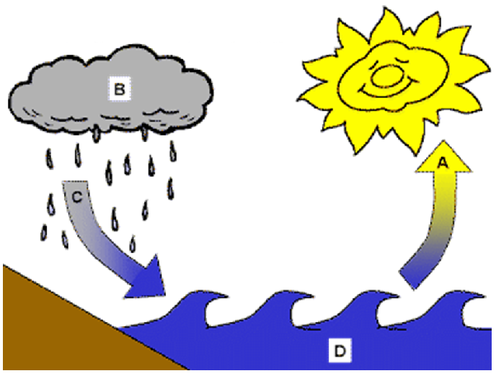

Slide 13
Water Cycle Song
Let your ears enjoy this song:

Slide 14
And that’s the Water Cycle!
Ain’t it great?!?!

