Slide 1
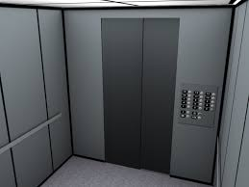
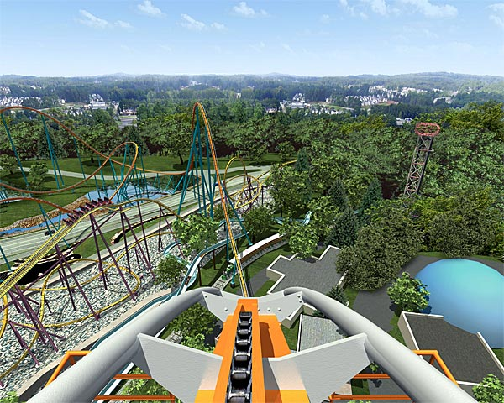
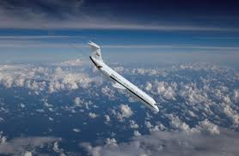
Ever been on one of these before?

Slide 2
Weightlessness
- the absence of (without) weight
-a.k.a - free falling, zero gravity, and microgravity

Slide 3
Free Falling
1. Place your thumb over the hole in the bottom of the cup.
2. Fill the cup with water up to the line bottom of the lip.
* What will happen to the water inside the cup if you remove your thumb from over the hole?
3. CAREFULLY stand on a chair and hold the cup directly above the plastic container on the floor.
4. Remove your thumb from the hole and allow a small amount of water to stream from the hole and fall into the empty container. Quickly place your thumb over the hole to stop the flow of water.
5. Refill the cup to the bottom of the lip.
* If you were to release the cup, allowing it to fall toward the container, will water flow from the hole during its fall?
6. CAREFULLY stand on a chair and hold the cup directly over the container.
7. Remove your thumb from the hole allowing a steady stream to start and on the count of 3, release your fingers and let the cup drop.
* What happened?

Slide 4
What's going on???
The gravitational force pulls the water through the hole in the container as long as the container remains motionless. But when the cup is set in motion (dropped) and allowed to free fall toward the empty tray, the water remains inside the container because there is an equal amount of gravity being exerted on the container and the water inside the container.
This is the same thing as "free falling"
or being "weightless" in outer space.
Think of the cup as representing the space shuttle and the water is like the astronauts.

Slide 5
Tying it together...
1. What is happening to an astronaut in a space shuttle in orbit?
They are falling inside the shuttle, which is falling.
2. Why do astronauts seem to float in the space shuttle?
They are falling at the same speed as the space shuttle.

Slide 6
The Effects of Weightlessness on the Body
Materials:
30 marbles
Plastic milk container
Wide Rubber Band
Procedure:
1. Hang the plastic milk container by the rubber band to the a hook on the wall.
2. Fill the container with ten marbles. Watch and observe the rubber band.
* What happens?
3. Add another ten marbles. Make observations.
4. Add the final ten marbles and make observations.
* What happens to the rubber band? Why?
* How does this show the pull of gravity?
* How do you think weightlessness changes your body? Your height? Your appearance?

Slide 7
What's going on???
Imagine that the vertebrae in your back form a giant spring. Pushing down on the spring keeps it coiled tightly. When the force is released, the spring stretches out. In the same way, the spine elongates by up to three percent while humans travel in space. There is less gravity pushing down on the vertebrae, so they can stretch out - up to 3 in. (7.6 cm).
To some degree, a similar stretching of the spine happens to you every night. When you lie down, gravity isn't pushing down on your vertebrae. Measure your height carefully as soon as you get up or while you are still lying down. You will find that you're about a centimeter or two taller. As the day passes, your vertebrae compress through normal activities, and you'll lose those few centimeters you "grew" overnight.

